Slide 1



Source Code Management
Automation Server
Artifact Repository
Manage Source
Build and Test
Manage Release

Slide 2



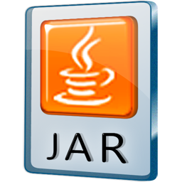


START PIPELINE
Checkout SCM

Slide 3
1 - Get source and pom.xml info
Checkout SCM

Slide 4
1 – Copy the Release Artifact from Nexus Releases Repository
Checkout SCM
Download Artifact

Slide 5
1 – Get Local Copy of Artifact
Checkout SCM
Download Artifact
Deploy Mule App

Slide 6
1 – Get Local Copy of Artifact
2 – Deploy Mule App to Cloudhub (Runtime Manager)
Checkout SCM
Download Artifact
Deploy Mule App

Slide 7
Pipeline END
Checkout SCM
Download Artifact
Deploy Mule App

Slide 8
1-Trigger pipeline
2-Checkout RELEASE
3-Copy Artifact
4-Deploy to Mulesoft
Checkout SCM
Download Artifact
Deploy Mule App
1
2
3
4

